Slide 1
INVESTMENT ASSIGNMENT SUBMISSION
Name: Himanshu Wadekar

Slide 2
Sparks Funds – Investment Analysis
Spark Funds is an asset management company and wants to make investments in a few companies.
The company has a overall strategy to invest in sectors and countries, in which maximum no. of investments are done.
Business constraints:
Company wants to invest between 5 and 15 USD million per round of investment.
Company wants to invest in English-speaking countries only.
Business objective: The objective is to identify the best sectors, countries, and a suitable investment type for making
Investments.
Goals of data analysis:
Investment type analysis
Country analysis
Sector analysis

Slide 3
Problem Solving Methodology
Understanding the Data
Realize , deep-dive into the data to understand the dataset.
Data Cleaning
Remove all the null, redundant entries. Splice off the closed companies records.
Funding Data Analysis
Best funding type based on 5-15 million USD range.
Start
Data Visualization & Conclusions
Visualize by plotting graphs and make decision based on the plots.
Sector Data Analysis
Extract the primary to main-sector mapping. Get top3 sectors for top3 countries.
Country Data Analysis
Choose Top9 countries for chosen investment type. Pick Top3 English-speaking countries.
Stop

Slide 4
Analysis of Data
The data for the analysis has been procured from cruncbase.com
Company Data: consists of data of all companies.
Investment Rounds Data : consists of data of past investments rounds details.
Mapping Data : consists of data mapping of primary sector to main sector.
English-speaking countries data : consists of list of countries that speak English.
Data Cleaning:
Remove unnecessary columns and columns which have null values.
Remove rows which have missing primary key
Remove data of companies that have been closed .

Slide 5
Funding Type & Country Analysis
To decide a specific funding type , we do the following steps:
Sum up the raised amount (in million USD) according to the funding type.
Consider only 4 types namely venture, seed, angle, private equity.
Take into account the constraint on raised amount , that it has to be between 5-15 million USD.
To do the country analysis, we proceed as mentioned below:
Get a list of countries which are English-speaking countries.
Pick top 9 countries among the list based on the amount raised by them (in million USD).

Slide 6
Sector Analysis
To do the sector analysis, we follow the following steps:
Extract the primary sector of each category list from the ’category_list’ column.
Map each primary sector to one of the eight main sectors .
3. Create three separate data frames D1, D2 and D3 for each of the three countries containing the observations of funding type FT falling within the 5-15 million USD range. The three data frames contain:
All the columns of the master data along with the primary sector and the main sector.
The total number (or count) of investments for each main sector in a separate column.
The total amount invested in each main sector in a separate column.

Slide 7
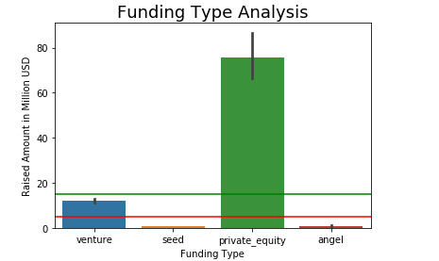
Results from Funding Type Analysis
The bar plot shows the total raised amount for 4 funding types
Avg. raised amount for angel , seed funding type is less than 5 million USD.
Avg. raised amount for private equity is greater than 15 million USD.
Venture type of funding has an average raised amount between 5 and 15 million USD.

Slide 8
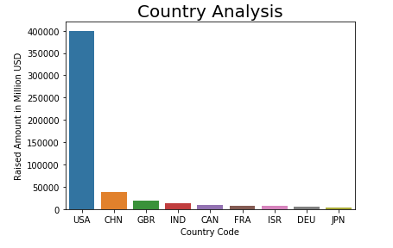
Results from Country Analysis
The Bar plot represents top 9 countries and sum of their total raised amounts (in million USD).
USA has the maximum sum of raised amount of around 400 thousand million USD.
China and Great Britain follow USA, but amount raised by USA massively exceeds both. But China is non English-speaking country.
So, top3 countries are USA, Great Britain and India.

Slide 9
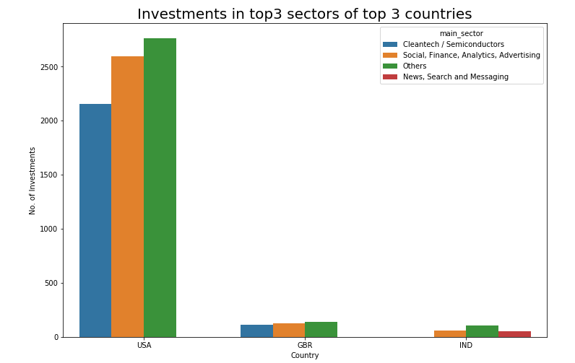
Results from Sector Analysis

Slide 10
Conclusions
Based on this detailed analysis, following conclusions have been derived for Spark Funds:
Funding Type: Venture
Country to Invest | Investing Sector
1. USA | Others Social, Finance ,Analytics and Advertising Cleaning/ Semiconductors
2. Great Britain | Others Social, Finance ,Analytics and Advertising Cleaning/ Semiconductors
3. India | Others Social, Finance ,Analytics and Advertising News, Search and Messaging

